Slide 1
SOFTWARE PROJECT LAB-I
Team-15
Web Based Shooting Game

Slide 2

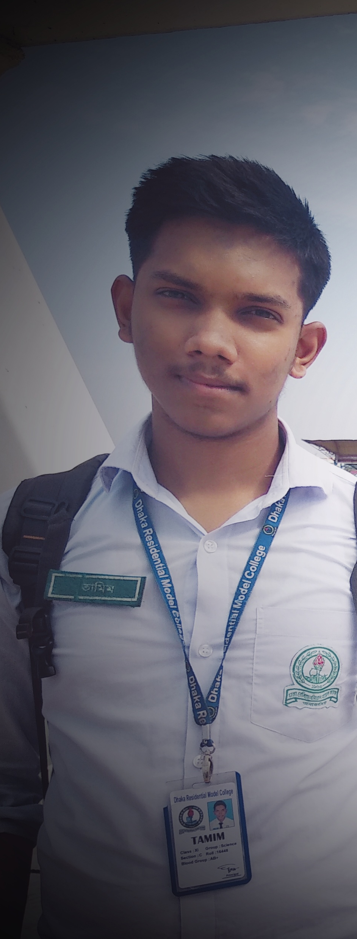

OUR TEAM
Md. Monowarul Amin
Md.Siamul Mubin Tamim
Sami-Ul Haque Showviq
ID: 200042112
ID: 200042130
ID: 200042156
1

Slide 3

ABOUT THE PROJECT
Game
2

Slide 4
OUR TIMELINE
WEEK 4 -5
WEEK 9-11
Finalizing The Proposal
Develpoing the fundamental coding
Planning
Proposal
FINAL
VERSION
WEEK 6-8
WEEK 12-14
Developing the base template
Working with database and front-end
3

Slide 5
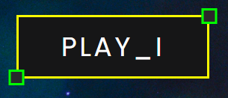



Pages:Home Page
There are “Four” buttons in the “Home Page”
4

Slide 6


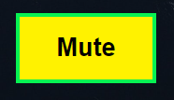

Pages: PLAY_I
After selecting the “PLAY_I” button it redirects to this page.
This is the simple implementation of our “Shooting Game”.
There are “Four” buttons in this page.
5

Slide 7
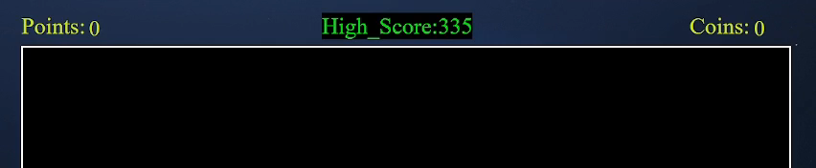
Pages: PLAY_I (Continue)
6

Slide 8
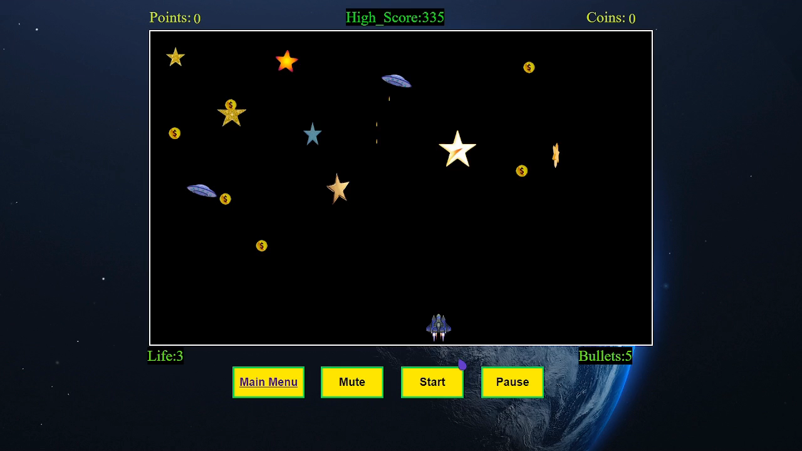
Pages: PLAY_I (Continue)
7

Slide 9
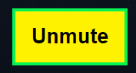





Pages: PLAY_I (Continue)
Bullet Count
Life
Points
Coins
Highest Score
8

Slide 10
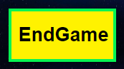
Pages: PLAY_II
After selecting the “PLAY_II” button it redirects to this page.
We try to implement “Theory of Relativity” here.
There are “Four” buttons in this page.
9

Slide 11
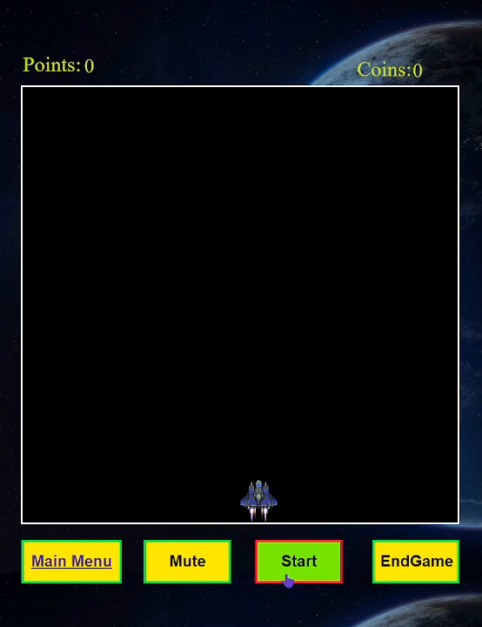
Pages: PLAY_II (Continue)
Considering Bullets as particle
Which has a finite lifetime.
Points
Coins
10

Slide 12
Pages: PLAY_II (Continue)
Moving towards right, we will consider far from earth.
Initially, bullet-velocity(Vb)= .5 * c where c is the light velocity
For each coin collection, the light velocity changes according to c = c * .99
The length for the gamer Lg = Lb * √(1 – v^2 / c^2)
Here Lb -> Length covered by bullet
Lg -> Length covered according to the gamer(observer)
If the value of the bullet increases, the part (1 – v^2 / c^2) -> 0
gets closer to zero , and the length Lg increases than that of the bullet.
11

Slide 13
The Problem We Faced
Storing Score
Using basic “Java Script”
12

Slide 14
THANKS!

